Slide 1
Embedded PowerPoint Video
Campus IM Coordinators
Welcome to the 2019 Meeting
By PresenterMedia.com

Slide 2
Proclamation 2019
Implementation School Year 2019-20
Newly Adopted Instructional Material
English Language Arts and Reading K-8
Spanish Language Arts and Reading K-6
Handwriting K-5 (English and Spanish)
Spelling K-6 (English and Spanish)
Personal Financial Literacy

Slide 3
Middle School NEW 2019 Titles
6th 7th and 8th Grade
Into Literature
6th, 7th and 8th Grade
Calkins Units of Study - Writing
6th, 7th and 8th Grade
Literacy Intervention

Slide 4
Elementary New ELAR Titles
Fountas & Pinnell
Guided Reading (GK-5)
Words That Sing Poetry Charts (GK-2)
Interactive Read Aloud (GK-5)
Shared Reading (GK-3)
Phonics, Spelling & Word Study (G3-5)
Lucy Calkins
Phonics Units of Study (GK-2)

Slide 5
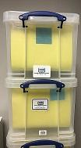
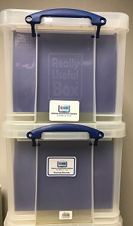
Elementary Assessments of Readiness & Literacy
Pioneer Valley
Level A-M, Fiction/Non-Fiction
Level N-T, Fiction/Non-Fiction
Level U-Z, Fiction/Non-Fiction to be added when published
fiction
non-fiction

Slide 6
Elementary Literacy Resources

Slide 7
Elementary New SLAR Titles
Additional Literacy Resources
Cengage
Colección Ventanas - Mentor Texts

Slide 8
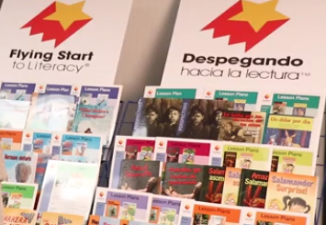
Elementary New SLAR Titles
Okapi
Flying Start to Literacy
- Guided Reading
Despegando hacia la lectura
McGraw Hill
Trade Library books - Shared Reading
Phonics, Spelling & Word Study
Components & Instructional related Resources

Slide 9
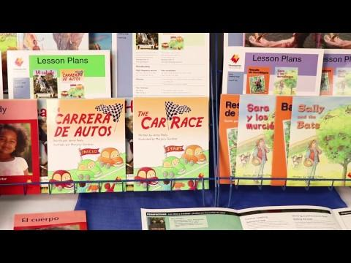

Slide 10
Elementary Adoption Distribution
ELAR Curriculum | ELA Teachers | ELA ALTs | SLA Teachers | SLA ELTs | SIP Teachers | Special Ed Contact | NOTES
Fountas & Pinnell
Guided Reading GK-G5 |  | x |  |  |  |  | 1/campus for each grade level - Campus assigned and checked out to ALT; stored in Literacy Library; ALT to create and manage a system for teacher use.
Words That Sing GK-G2 |  | x
Interactive Read Aloud GK-G5 | x | x | x |  |  | x | What is checked out to ALT can be stored in Literacy Library; will also be used by ELT
Shared Reading GK-G3 | x | x | x |  |  |  | What is checked out to ALT can be stored in Literacy Library; will also be used by ELT and S/E as needed
Reading Mini Lessons GK-G5 | x | x | x | x |  | x
Phonics Word Study G3-G5 | x | x |  |  |  | x
Literacy Continuum | x | x | x | x |  | x
Lucy Calkins
Phonics Units of Study GK-G2 | x | x |  |  |  | x
Literacy Supplemental Books
The Reading Strategies Book, Jennifer Serravallo | x | x | x | x | x | x
The Writing Strategies, Jennifer Serravallo | x | x | x | x | x | x
Patterns of Power, Jeff Anderson | x | x | x | x | x | x
Text Structures from the Masters, Gretchen Bernabei | x | x | x | x | x | x
Text Structures from Nursery Rhymes, Gretchen Bernabei | x | x | x | x | x | x

Slide 11
Elementary Adoption Distribution
SLAR Curriculum | SLA Teachers | SLA ELTs | SIP Teachers |  | NOTES
Okapi - Guided Reading
Dual Literacy - Flying Start to Literacy (English & Spanish) |  | x |  |  | Per Bi-Lingual & SIP campus - Campus assigned and checked out to ELT; stored in ALT Literacy Library; ELT to create and manage a system for teacher use, working with ALT.
Cengage National Geographic - Mentor Texts
Coleccion Ventanas GK-G6 (Spanish) | x | x | x |  | Per teacher - G5 to receive both G5 & G6 material
McGraw Hill - Shared Reading
Literature Big Book Pkg GK-G1 (Spanish) | x | x | x |  | SIP campuses do not receive GK
Classroom Trade Book Library G1-G5 (Spanish) | x | x | x |  | English GK-G3 "Shared Reading" is F & P
Classroom Trade Book Library G4-G5 (English & Spanish) | x | x | x |  | SIP teachers only receive Spanish
Components & Additional Instructional related Resources | x | x | x |  | SIP teachers only receive Spanish
Literacy Supplements
Gramatica y ortografia para primaria | x | x | x
Manual del lenguaje | x | x | x

Slide 12
Proclamation 2020
Implementation School Year 2020-21
English I, II, III, IV
Reading I, II, III
College Readiness & Study Skills
Visual Media Analysis & Production
Contemporary Media
Literary Genres
Creative Writing
Research & Technical Writing
Practical Writing Skills
Humanities
Public Speaking I, II, III
Communications Applications
Oral Interpretations I, II, III
Debate I, II, III

Slide 13
Proclamation 2020 (cont.)
Implementation School Year 2020-21
Journalism
Advanced Broadcast Journalism
Photojournalism
Advanced Journalism: Yearbook I, II, III
Advanced Journalism: Newspaper I, II, III
Advanced Journalism: Literary Magazine
English Language Learners Arts, 7-8
English for Speakers of Other Languages (ESOL), English I, II
English Language Development and Acquisition (ELDA)

Slide 14
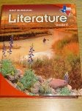
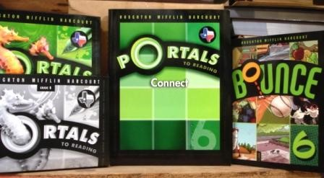
Middle School Out of Adoption Titles
6th, 7th and 8th Grade
Holt Literature
Portals &
Write Source TE’s

Slide 15
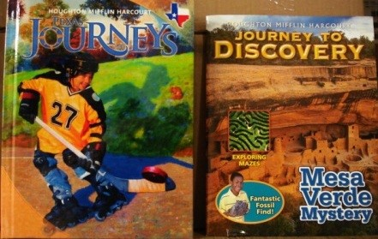
Elementary Out of Adoption Titles
K- 5th Grade
Journeys &
Senderos
Spelling, Handwriting & STAAR Prep
Handwriting Without Tears
Words Their Way
Journeys Write Source
(English & Spanish)

Slide 16
Preparation for Out of Adoption Collection
Request Quantity of Pallets
Request Delivery Date of Pallets
When Pallets are ready for pick up, email a Spreadsheet that includes the following for each pallet :
ISBN
Title
Quantity of Each Title
The Spreadsheet will be the Work Order for the pick up of pallets

Slide 17
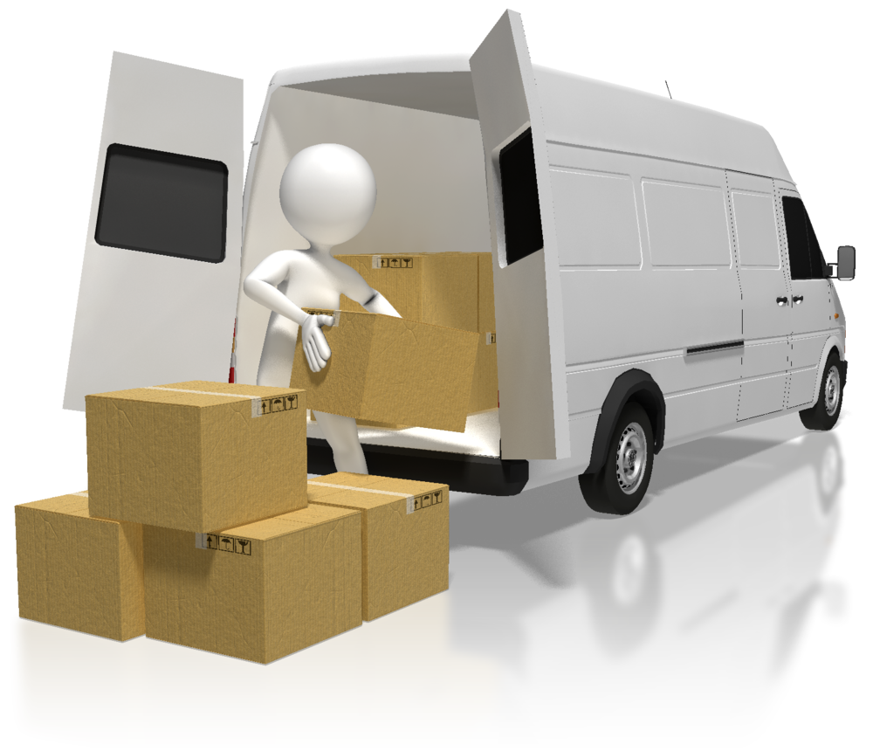
Warehouse Collections
ELAR Material
Student Textbooks
Teacher Resources
NO WORKBOOKS
SUMMER COLLECTIONS:
Just in case the new material does not arrive in time for next school year, please keep enough material for the first of school until the new material arrives (Example G4-5)

Slide 18
Workbooks/Consumables/Write-in Textbooks
Generated Ideas for Used Consumables
Mostly Used
Send home with student at the end of the year
Dispose of when cleaning out classroom, after students have left for the year
Slightly Used
Send home corresponding pages throughout the year
Keep and use different parts next year
Can NOT
Throw away slightly used and unused in the dumpster
Send home slightly used and unused

Slide 19
How to Stack Material onto Pallets
Stack textbooks in layers not towers
Binding to the outside if possible
Teacher material on top or on separate pallet
Set pallet a few inches away from the wall
Make sure pallet slots are at correct position for pallet jack

Slide 20
Collection of Out of Adoption Material Elementary and Middle Schools – Proclamation 2019
Warehouse
Collection Dates
June 3 – 28, 2019
July 8 – 31, 2019

Slide 21
Audit Processes & Best Practices
Mid Term Audit - Soft Self Audit
Touch base with all teachers
Collect one semester course books
Quick inventory of book room
Consumable Audit - February
- Reminder/completion deadline sent in advance
- Done in TipWeb
- Once completed, the original number sent to campus is
zeroed by Cathy so that new requisitions can be entered

Slide 22
Audit Processes & Best Practices
Prep for Physical Audit (before end of year audits)
- Have a “plan of action” for collecting of materials
Self Audit
- Due by the last day of school (Electronic submission via
TipWeb)
- Audit Team physically counts and verifies what the campus
has entered for their self audit of instructional material
Physical Audit
- Each campus receives one yearly
- Audit invoices paid same fiscal year

Slide 23
Student Distribution Report

Slide 24
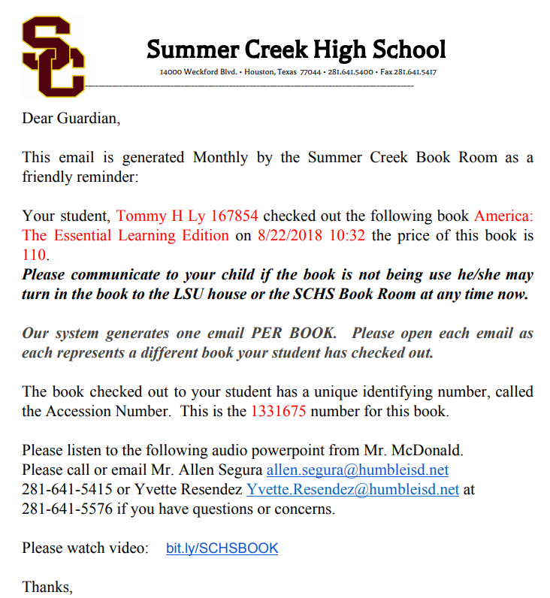
Parent/Student Email - Example
https://drive.google.com/drive/u/0/my-drive

Slide 25
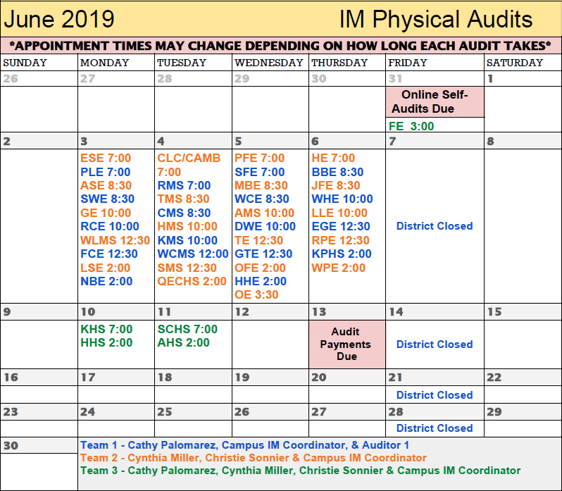
Audit Schedule

Slide 26
Book Room Audit Preparation
Clean Out Book Room
Clean off Book Shelves
Samples
Out of adoption materials
Storage files
Clutter

Slide 27
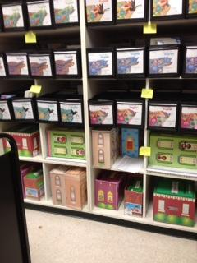
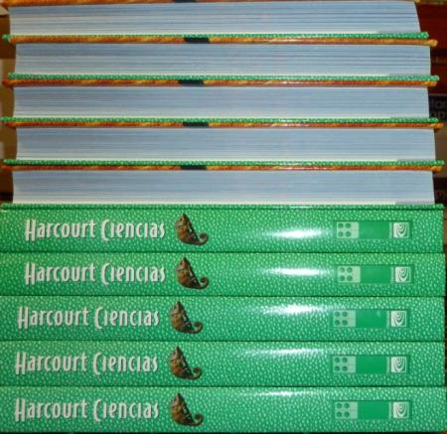
Book Room Audit Preparation
Collect all material into
Central Location
Arrange by SLC (grade-subject)
Stack Books 5x5
or 10x10
Alternate the
Binding/Titles

Slide 28
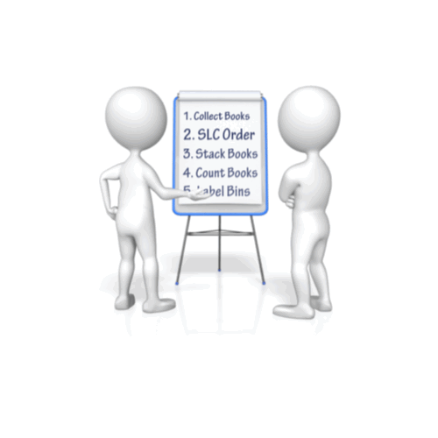
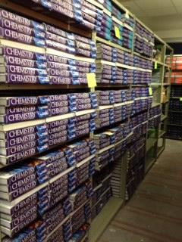
Book Room Audit Preparation
Same number of books per bin
Example: 160 books = 4 bins/shelves with 40 books each
Label Bins with
merged “Post It”
labels

Slide 29
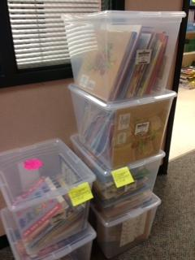
Book Room Audit Preparation
Check all Teacher Material
Make sure all components are together
Note any missing pieces

Slide 30
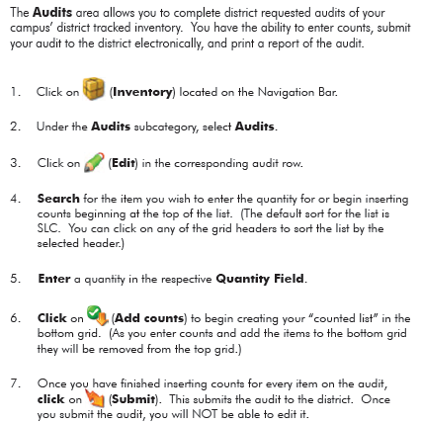
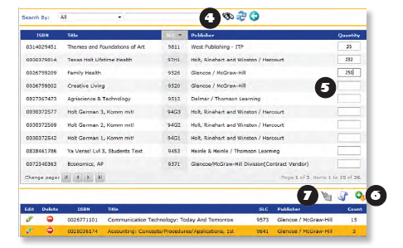
Self Audit in TIPWeb

Slide 31
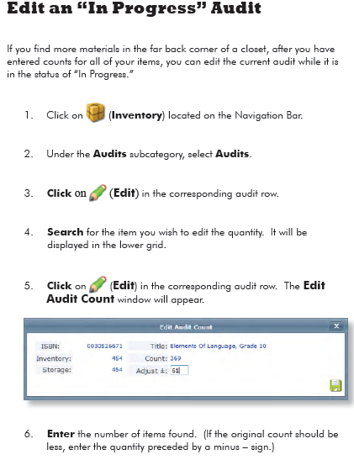
Self Audit in TIPWeb

Slide 32
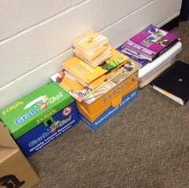
Audit Preparation
Please DO NOT:
Stack books outside of classrooms
Have Teacher Edition
stacked with Student
Books
NO “Scavenger Hunt” allowed

Slide 33
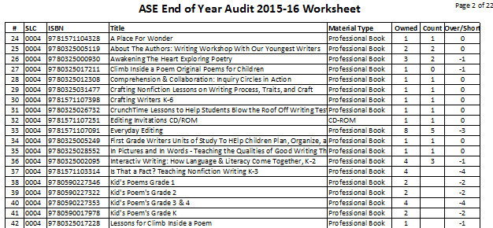
Physical Audit XL Worksheets

Slide 34
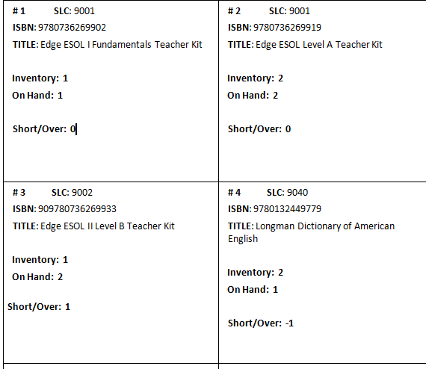
Physical Audit Merged “Post It” Bin Labels
Merge IM XL Worksheet and Label Word Doc
Print on colored paper and cut out
Attach to appropriate bin, shelf, container

Slide 35
Audit Preparation

Slide 36
Audit Invoices
Audit Invoice Payments Due:
June 13, 2019
Audit Invoices (Paid Adjustments) will be sent via email and available to view in TIPWeb IM
** No Recounts **

Slide 37
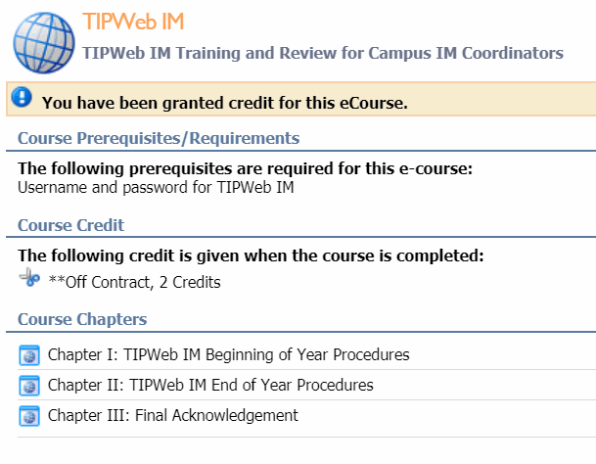
Required Annual Training in Eduphoria

Slide 38
You
ROCK
Those
Hats!

